Slide 1
Recursion

Slide 2
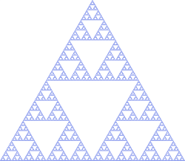
Description
“Defining a problem in terms of itself”
It is essentially a function/method calling itself
Comes directly from mathematics where you have a function f(x) = f(x-1) …
Can be used to solve problems in a compact way
Reduces the program size
Recursion can be used with lots of principles like Graph Theory (DFS) and dynamic programming (dp)
LOTS of contest problems use recursion in one way or another

Slide 3
Basics
Recursion is used to break up the original problem into smaller problems
All recursive functions contain a base case and a case that breaks the problem down into smaller ones
Base case: the case where you have reached the end of the recursion so you simply return an integer (most likely 0 or 1)
Other case: you recursively call on the function itself, but with a smaller constraint of the original problem
Eg. return f(x - 1)
*There are two popular applications for recursion* ---->

Slide 4
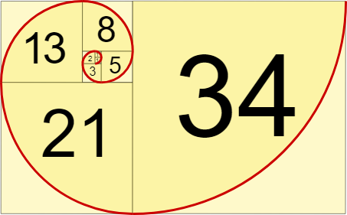
Fibonacci
Find the nth Fibonacci number
int fib(int n) {
if(n <= 1) return n; //Base case
return fib(n-1) + fib(n-2)
}

Slide 5
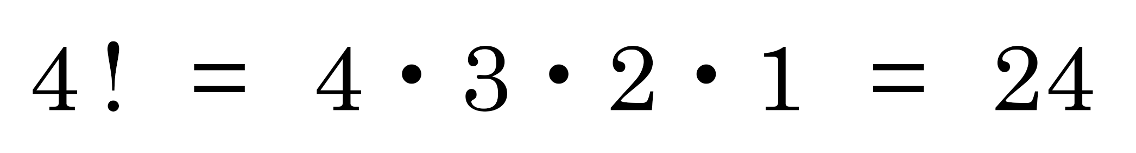
Factorial
Calculate the factorial of a number using recursion
int factorial (int n){
if n == 1
return 1
return n * factorial (n-1)
}

Slide 6
Dangers
Too many recursive calls results in stack overflow
You need a base case so that the recursion does not go on infinitely
Recursion can sometimes be a bad sign for time complexity (Include DP)

Slide 7
Problems
https://dmoj.ca/problem/dwite09c1p2
https://dmoj.ca/problem/ccc96s3
https://dmoj.ca/problem/ccc05j5
https://dmoj.ca/problem/ccc08s4

